Slide 1
Cognitive Search and Augmentation
Sergio Ortega

Slide 2

messy room picture here
Notes:
However, this is not just Stock photos. This is a real photo from one of our customers as produced by the account team – this is actually from the Department of Justice of a country that I will not name, for obvious reasons.
In fact, many legal companies use this methodology as a DDOS attack on other legal department, by providing millions of documents in TIFF format, which is the digital equivalent of this.

Slide 3






Microsoft Cognitive Services
Give your apps a human side
Vision
From faces to feelings, allow your apps to understand images and video
Speech
Hear and speak to your users by filtering noise, identifying speakers, and understanding intent
Language
Process text and learn how to recognize what users want
Knowledge
Tap into rich knowledge amassed from the web, academia, or your own data
Search
Access billions of web pages, images, videos, and news with the power of Bing APIs

Slide 4
Microsoft Cognitive Services
Give your apps a human side
Computer Vision
Content Moderator
Emotion
Face
Video
Video Indexer
Custom Vision Service
Bing Speech
Speaker Recognition
Custom Speech Service
Bing Spell Check
Linguistic Analysis
Text Analytics
Translator Text & Speech
Web Language Model
Language Understanding
Academic Knowledge
Entity Linking
Knowledge Exploration
Recommendations
QnA Maker
Custom Decision Service
Bing Autosuggest
Bing Image Search
Bing News Search
Bing Video Search
Bing Web Search
Bing Entity Search
Bing Custom Search
Vision
Speech
Language
Knowledge
Search

Slide 5
Enriching content through Cognitive Services

Slide 6
When to use it
How to identify Cognitive Search Opportunities
Every company has ppts, pdfs, docx, html, images…
Every company has contracts, forms, plans, memos, emails
Every company needs compliance, risk detection
Client needs a better search experience on top of business documents
Local file server is out of space
Client already has data on Azure
Client needs to apply AI to business documents: data != information

Slide 7
How It Works?

Slide 8
How it works
Ingest
Any Data format
Any Azure Store
Enrich
Cognitive Skills
Explore
Azure Search API
Portal
Cognitive Search Pipeline

Slide 9







How it works
Data Enrichment: Atomic cognitive processes applied for each document, creating metadata
Entity recognition skill
Language detection skill
Key phrase extraction skill

Slide 10






How it works – Cognitive Search Pipeline
Data
Source
Enriched
Documents
Ingest Enrich Explore

Slide 11
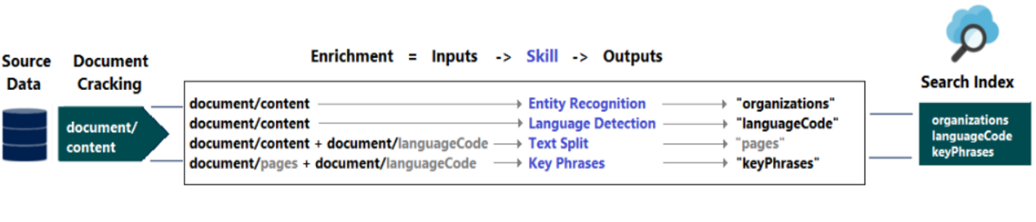
How it works – Cognitive Search Pipeline
Ingest Enrich Explore
Notes:
The enrichment pipeline adds annotations (outputs) to the document
Annotations can be simple or an array of elements
Elements can be referenced within the pipeline execution

Slide 12
Analyzing text
Matthew Henson was born in 1866. Peary hired him as a valet, and the two began a long working relationship that spanned half a dozen epic and amazing travels over two decades. In 1887, it was not easy to access Aspirin or Ibuprofen, think how challenging it might have been reaching the North Pole.

Slide 13
Analyzing text
Text Analytics
Language: English
Sentiment: Positive
Key Phrases : dozen epic, amazing travels, Aspirin, Ibuprofen, long working relationship, decades, Matthew Henson, Peary, valet, North Pole
Matthew Henson was born in 1866. Peary hired him as a valet, and the two began a long working relationship that spanned half a dozen epic and amazing travels over two decades. In 1887, it was not easy to access Aspirin or Ibuprofen, think how challenging it might have been reaching the North Pole.

Slide 14
Analyzing text
Text Analytics
Language: English
Sentiment: Positive
Key Phrases : dozen epic, amazing travels, Aspirin, Ibuprofen, long working relationship, decades, Matthew Henson, Peary, valet, North Pole
Matthew Henson was born in 1866. Peary hired him as a valet, and the two began a long working relationship that spanned half a dozen epic and amazing travels over two decades. In 1887, it was not easy to access Aspirin or Ibuprofen, think how challenging it might have been reaching the North Pole.
Entity Linking Intelligent Service
Entities Identified

Slide 15
Analyzing text
Text Analytics
Language: English
Sentiment: Positive
Key Phrases : dozen epic, amazing travels, Aspirin, Ibuprofen, long working relationship, decades, Matthew Henson, Peary, valet, North Pole
Matthew Henson was born in 1866. Peary hired him as a valet, and the two began a long working relationship that spanned half a dozen epic and amazing travels over two decades. In 1887, it was not easy to access Aspirin or Ibuprofen, think how challenging it might have been reaching the North Pole.
"entityTypeHints": [ "Person" ],
"entityTypeDisplayHint": "Explorer"
Entity Linking Intelligent Service
Entities Identified
"entityTypeHints": [ "Drug"
Bing Entity Search API
Entities Type
"entityTypeHints": [
"Place"

Slide 16
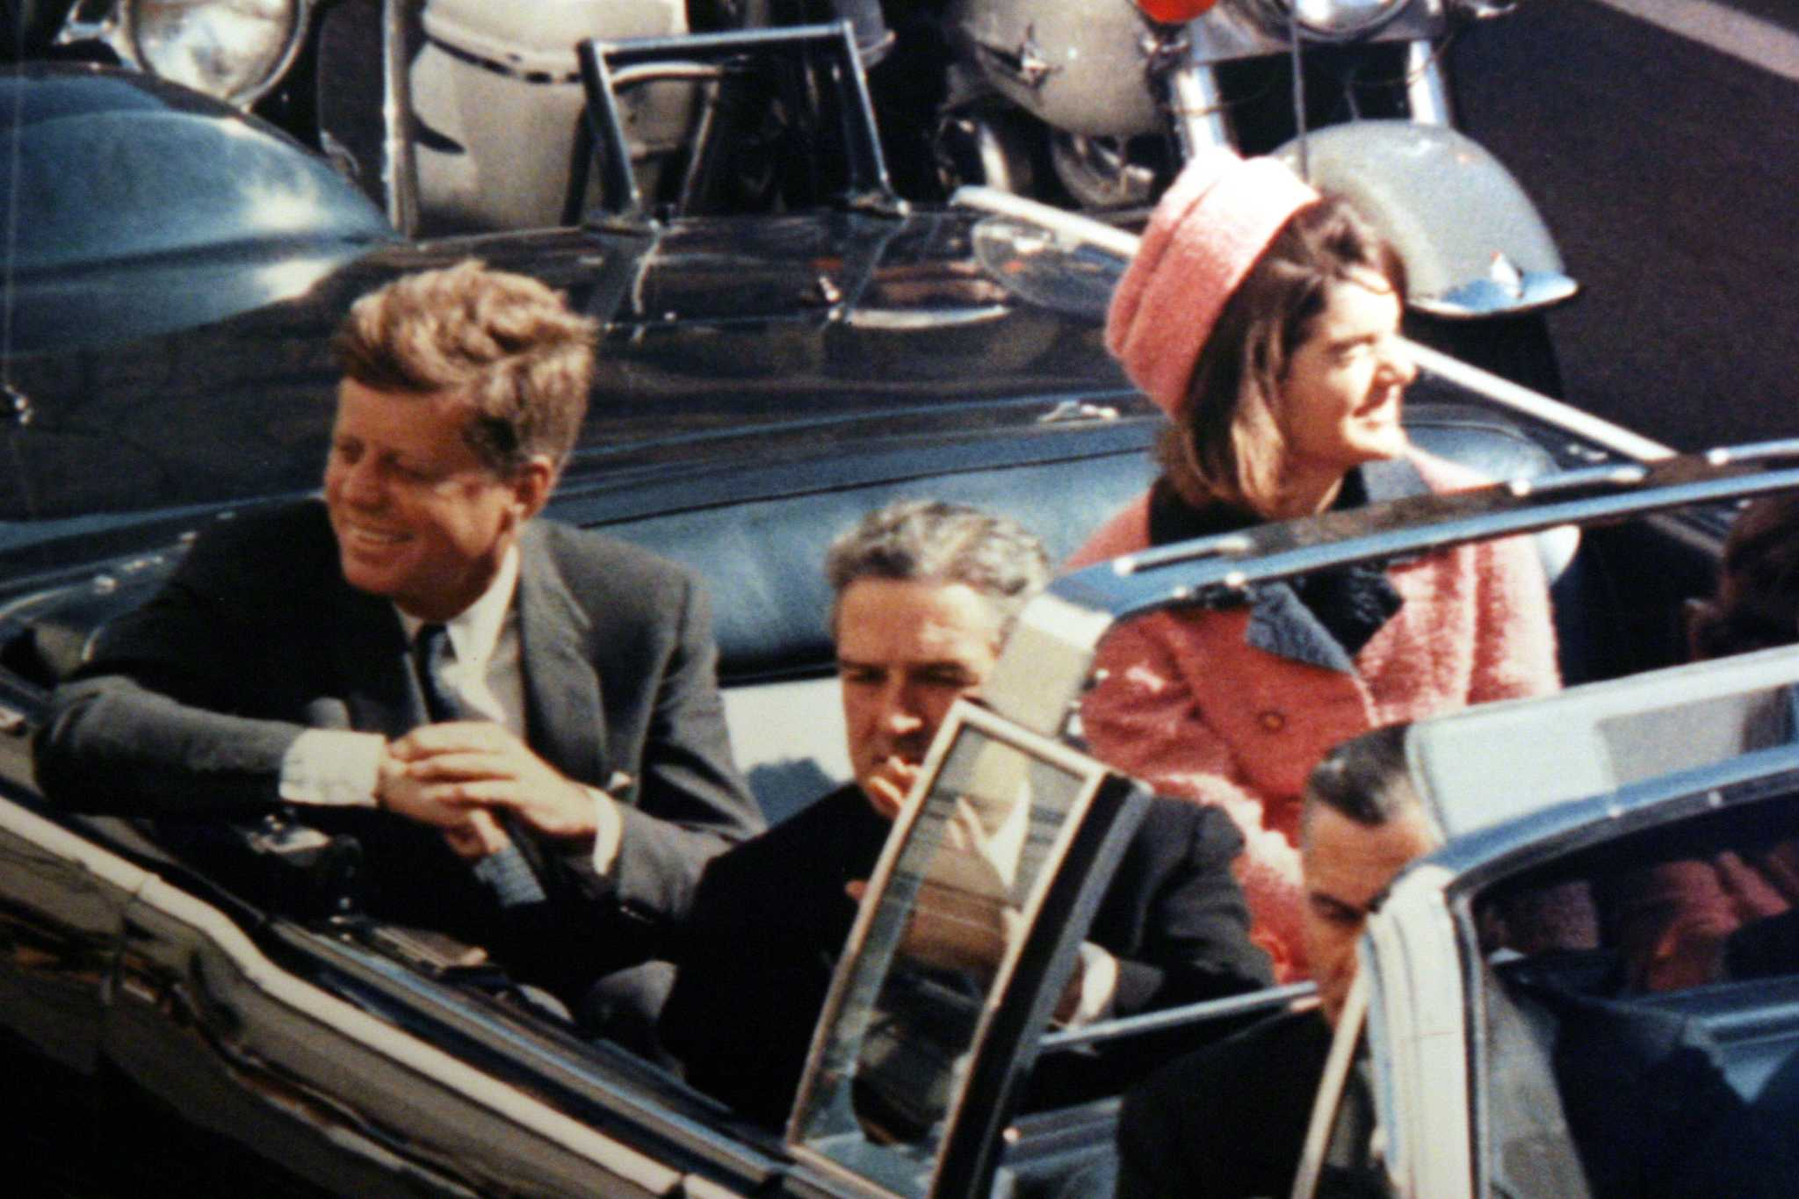

John F. Kennedy (JFK)
November 22, 1963

Slide 17




Slide 18


T H E JFK F I L E S
The truth is in there

Slide 19
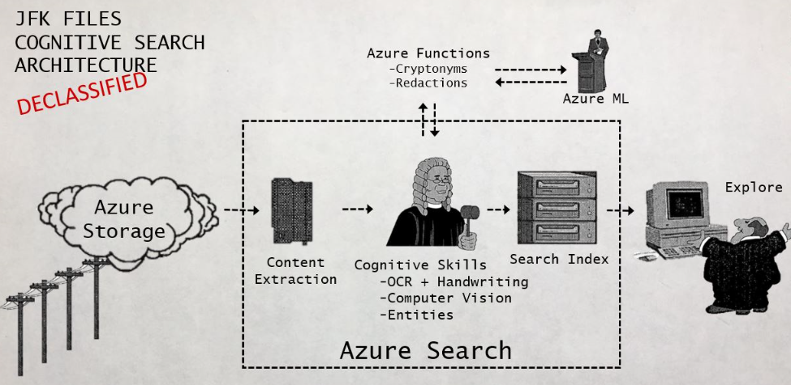
How it works – New Architecture

Slide 20



Analyzing legal contracts
Understanding engineering plans
Extracting form information
http://aka.ms/jfkfiles
Notes:
And while we showed you a problem the CIA might have, imagine how the Cognitive Search pattern could be applied on your data, or your customers’ data. Whether it’s analyzing legal contracts, understanding engineering diagrams, or automatically extracting information from manually filled forms. Come join us on our journey as we build together the solutions to power new experiences on top of your piles of unstructured data.

